Slide 1
TOPIC – FUNCTIONS IN PYTHON

Slide 2
LEARNING OBJECTIVEs
Understanding a Function
Defining Functions in Python
Executing the Flow of a Function
Passing Parameters
Returning values from a Function
Finding scope of Variables
Determining Mutable/ Immutable properties of
passed data objects

Slide 3

Why I need a Function????
A function is a subprogram that acts on
data and often returns a value.

Slide 4
Python Function Types
Broadly Python functions can belong to one of the following three categories:-
Built-in function
Function defined in modules
User defined function

Slide 5
Built in Functions
Type conversion Functions:-These are the functions which converts the value from one type to another.
Eg- int(), str(), float()
2. Input Function:- This function is used to take input from the user in the form of string.
Eg- name=input(“Enter your name”)
3. Eval Function:- This function is used to evaluate the value of a string.
Eg:- x=eval(“45+10”)
print(x) #ans will be 55

Slide 6
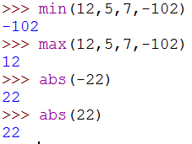
Built in Functions
4. min Functions:-This function returns the smallest value among given list of values.
5. max Function:-This function returns the biggest value among given list of values.
6. abs Function:- This function returns the absolute value of any integer which is always positive.

Slide 7
Python Modules
Module is a .py file which contains the definition of functions and variables.
When we divide a program into modules, then each module contains functions and variables and each function is made for a specific task.
When we make such functions which may be used in other programs by importing it.

Slide 8


Python Modules
Python provides two ways to import a module:-
import statement: to import full module.
from: to import all or selected functions from the module.

Slide 9
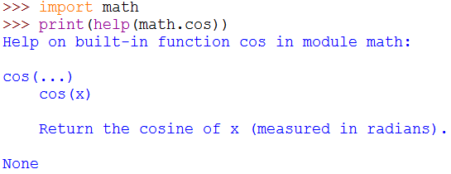
help Function
If you forgot that how a library function works then help() is very useful for this situation.
It can be used in any module.

Slide 10
User-defined Function
These are the functions which are made by user as per the requirement of the user.
Function is a kind of collection of statements which are written for a specific task.
We can use them in any part of our program by calling them.

Slide 11
Function in terms of Programming Language
In the given polynomial: 2x²
For x=1, it will give the result as 2x1²=2
For x=2, it will give the result as 2x2²=8
For x=3, it will give the result as 2x3²=18
Now if we will represent the above polynomial like
f(x)= 2x²
Then we can say that,
f(1)=2
f(2)=8
f(3)=18
What you observe:-
A value is needed (argument)
Can perform certain operation
Can return a result

Slide 12
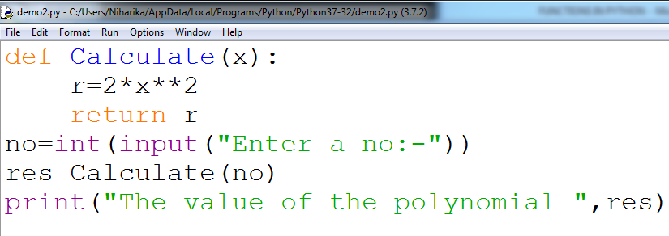
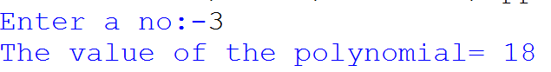
Defining Functions in Python
Keyword
Function name
Parameter
Body of the Function
Output
Function calling

Slide 13
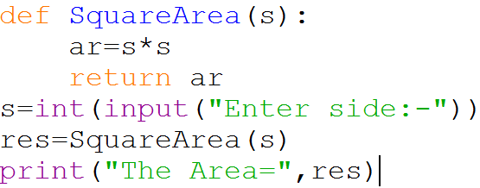
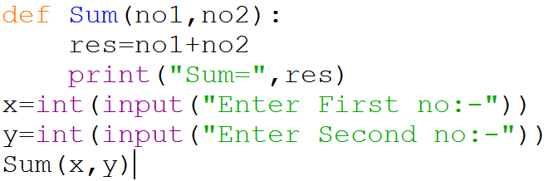
Lets look at some more examples
Sample Code-1
Taking one parameter and has return value
Sample Code-2
Taking two parameters and has no return value

Slide 14
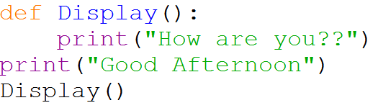
Structure of a Python Program
In Python program, generally all function definitions are given at the top followed by statements which are not part of any function. These are called as top level statements .
The python interpreter starts the execution of the program from the top level statement.
Python gives a special name to top level statements as __main__.
Example:-
1
2
3
4
Top level statement

Slide 15
Flow of Execution of a Function Call
The flow of execution refers to the order in which the statements are executed during a program run.
def Func():
.
.
return
#__main__
.
.
Func()
print(…)

Slide 16
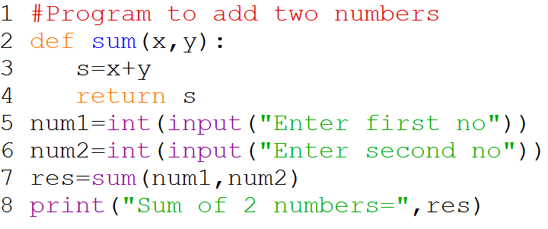
Determine the flow of execution of the following program
Answer
2→5→6→7→2→3→4→7→8

Slide 17
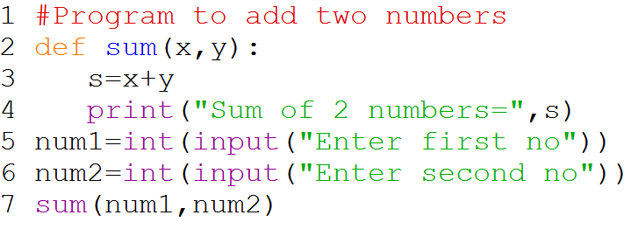
Determine the flow of execution of the following program???
Answer
2→5→6→7→2→3→4

Slide 18
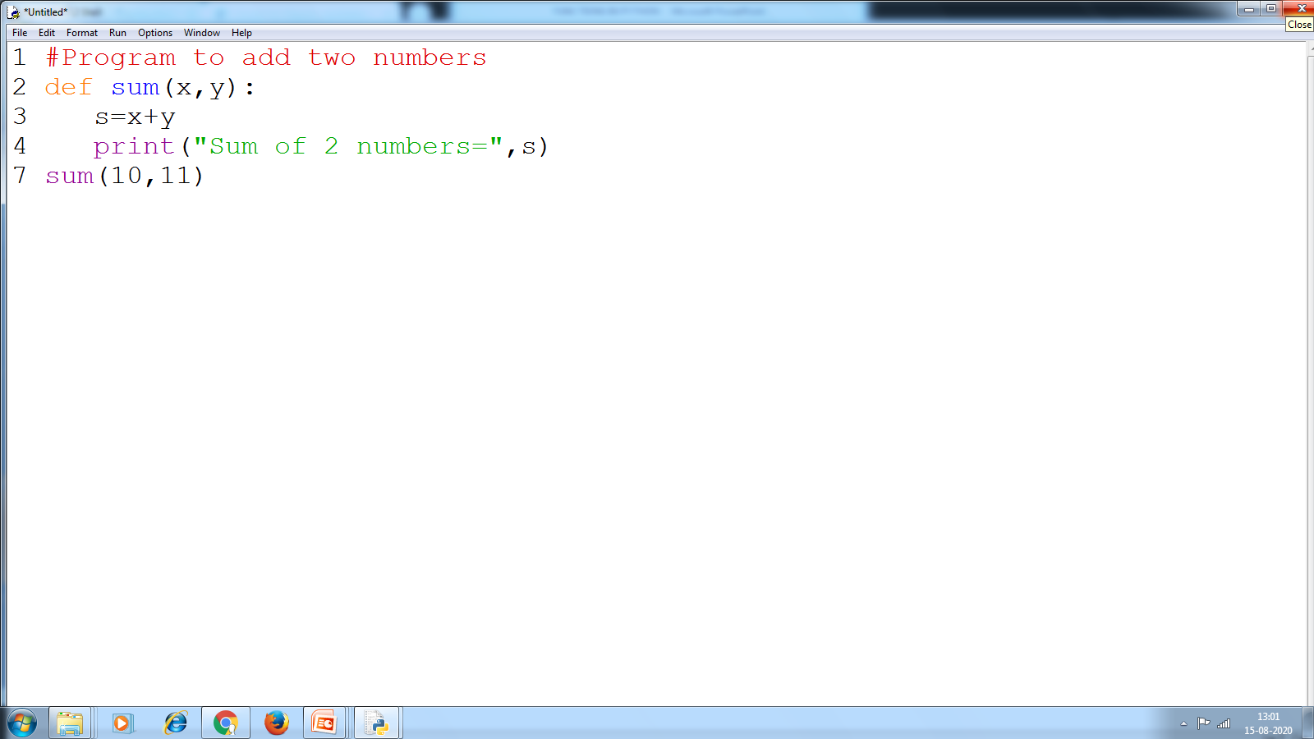
Argument and Parameter
Argument appears in function call statement.
Parameter appears in function header.
The alternate name for arguments are Actual Argument and parameter is Formal parameter.
Example:-
10,11 are called as Argument/ Actual Argument
x,y are called as parameter/ formal parameter.

Slide 19

Argument and Parameter
Argument in Python can be a:-
Literal
Variable
Expressions
But, parameters have to be some names.
Thus, for the function as defined below:-
def Multiply(a,b):
return (a*b)
Find the valid function call statements:-
1) Multiply(3,4)
2) P=9
Multiply(P,5)
3) Multiply(P,P+1)
Valid
Valid
Valid

Slide 20
PASSING PARAMETERS
Python supports four types of parameter:-
1
Positional Argument (Required Argument)
2
Default Argument (Optional Argument)
3
Keyword Argument (Names Argument)
4
Variable Length Argument

Slide 21
1. Positional Argument
You need to match the number of arguments with number of parameters required. For example if the function definition is:
def Example(a,b,c)
The possible call to this function is
Example(x,y,z)
Example(3,y,z)
Example(3,4,z)
Example(3,4,5)
Positional Argument or Required Argument or Mandatory Argument

Slide 22
2. Default Argument
Default argument is a method of assigning some default value to the function parameter. The parameter having default value in function header is known as a default parameter.
For example:
def Example(a,b,c=10)
The possible call to this function is
Example(x,y,z)
Example(x,y)
Default Argument

Slide 23
One important thing about default parameter is:
In default header , any parameter cannot have default value unless all parameters appearing on its right have their default values.

Slide 24
Examples of function headers with default value:
def SI(P,T,R=0.10):
def SI(P,T=2,R):
def SI(P=2000,T=2,R):
def SI(P,T=2,R=0.10):
def SI(P=2000,T=2,R=0.10):
Valid
Invalid
Invalid
Valid
Valid

Slide 25


Let’s Find out
def example(a,b,c=10,d=20):
Justify
1. example(30, 35)
2. example(90)
3. example(90,87,100)
4. example(90,87,20,30)
5. example( )

Slide 26
3. Keyword/Named Argument
Keyword arguments are the named arguments with assigned values being passed in the function call statement.
Python provides a way of writing function call where you can write any argument in any order provided you name the arguments when calling the function.
For example:-
def SI(P,R,T):
The above function can be called by-
SI(P=2000,T=2,R=0.02)
SI(T=4,P=2000,R=0.02)
SI(T=2,R=0.09,P=2000)

Slide 27
Rules for combining all three types of arguments together:
An argument list must first contain positional argument followed by any keyword argument.
Keyword arguments should be taken from the required arguments preferably.
You can not specify a value for an argument more than once.
Having positional arguments after keyword arguments will result into error.

Slide 28
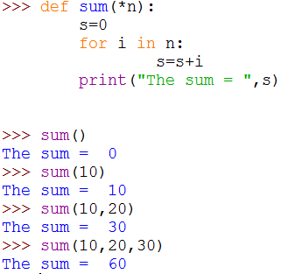
4. Variable Length Argument
As we can assume by the name that we can pass any number of arguments according to the requirement. Such arguments are known as variable length arguments.
We use (*) asterisk to give variable length arguments.
You can notice here that every time the number of arguments are different and the answer is calculated for each number of arguments.

Slide 29


Find legal/ illegal function call statement
Example(a=3000,b=5)
1
2
Example(d=0.12,a=3000,b=4)
Example(b=4,d=0.12,a=3000)
3
Consider the following function header:-
4
Example(5000,5,d=0.45)
def Example(a,b,c=2,d=0.2):
return (a+b+c+d)
Example(d=0.56,3000,5)
5
Example(5000,a=200,b=6)
6
Example(5000,e=500,b=7)
7
Example(600,c=6,d=0.06)
8

Slide 30
RETURNING VALUES FROM FUNCTIONS
There broadly 2 types of return in python
1
Function returning some value (non-void function)
2
Function not returning any value (void function)

Slide 31
1. Function returning some value (Non-void Function)
The function that return some computed result in terms of a value, fall in this category. The computed value is returned using return statement as per syntax:-
return <value>
The values being returned can be one of the following:
A literal
A variable
An expression
Some legal return statement
return 12
return a
return a**3

Slide 32
The return value of a function should be used in the caller function/ program inside an expression or a statement.
A function returning a value is known as fruitful function
Res=sum(a,b)
print(sum(10,20))
sum(10,20)>6

Slide 33
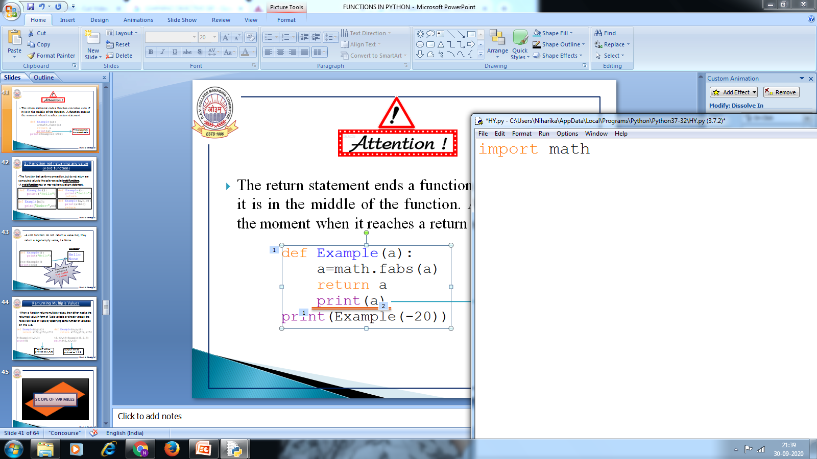
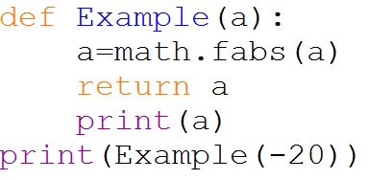
The return statement ends a function execution even if it is in the middle of the function. A function ends at the moment when it reaches a return statement.
This statement is unreachable

Slide 34
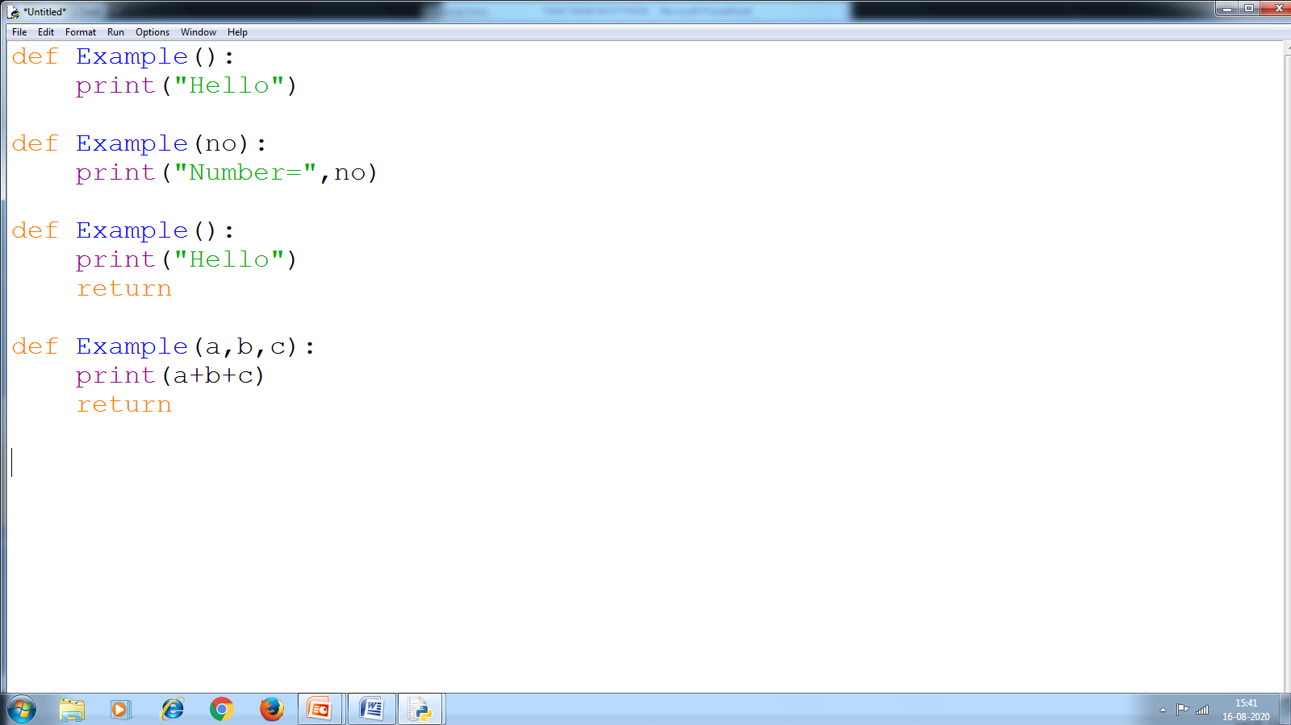
2. Function not returning any value (void function)
The function that perform some action, but do not return any computed value to the caller are called void functions.
A void function may or may not have a return statement.

Slide 35
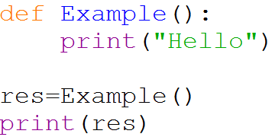
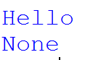
A void function do not return a value but, they return a legal empty value, i.e None.
Output:-
A void function is called as a
non fruitful function

Slide 36
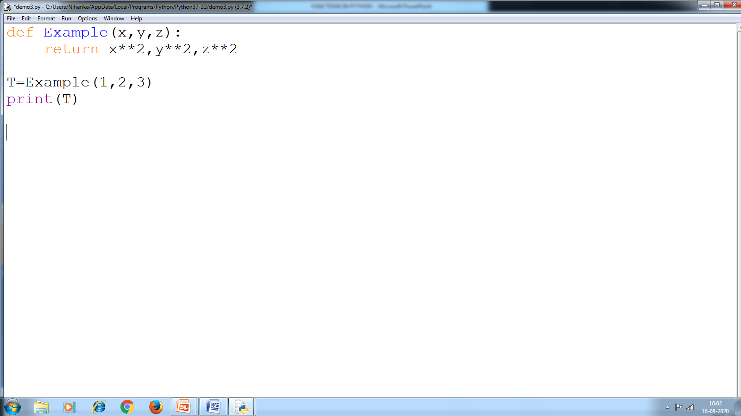
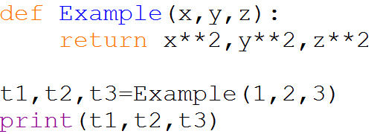
Returning Multiple Values
When a function returns multiple values, then either receive the returned value in form of Tuple variable or directly unpack the received value of Tuple by specifying same number of variables on the LHS.
Tuple T will be printed as (1,4,9)
Output will be printed as 1 4 9

Slide 37
SCOPE OF VARIABLES

Slide 38
The scope rule of a language are the rules that decide, in which part(s) of the program, a particular piece of code or data item would be known and can be accessed there in.
Types of scopes in python
Global Scope
Local Scope

Slide 39
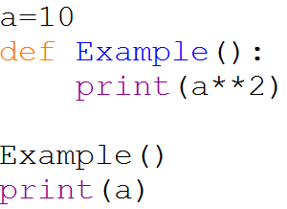
1. Global Scope
A name declared in top level segment (__main__) of a program is said to have global scope and is usable inside the whole program and all blocks (functions and other blocks) contained within the program.
Here ‘a’ has global scope and ‘a’ is called as a Global Variable

Slide 40
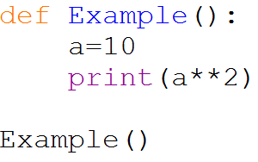
2. Local Scope
A name declared in a function body is said to have local scope i.e. it can be used only within this function and the other blocks contained under it. The formal arguments also have local scope.
Here ‘a’ has local scope and ‘a’ is called as a Local Variable

Slide 41
Memory allocation of Global and Local Variable
1. def Sum(a,b):
2. res=a+b
3. return res
4. no1=int(input(“Enter first no:”))
5. no2=int(input(“Enter second no:”))
6. s=Sum(no1,no2)
7. print(“Sum=“,s)
Global Environment
no1=10
no2=15
Local Environment
a=10
b=15
res=25

Slide 42
Name Resolution (Resolving Scope of a Name)
Name resolution rule is known as LEGB Rule.
L
Local Environment
E
Enclosing Environment
G
Global Environment
B
Built-in Environment

Slide 43
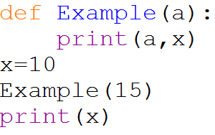
Case-1 (Variable in Global Scope, but not in Local Scope
Here ‘a’ is a Local Variable
Here ‘x’ is a Global Variable
Output is
10
10

Slide 44
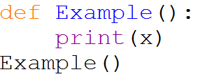
Case-2 (Variable neither in Local scope nor in Global Scope)
Here ‘x’ is neither defined in local scope nor defined in global scope
ERROR!!

Slide 45
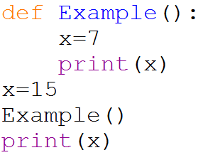
Case-3 (Same variable name in local scope as well as in global scope)
Here ‘x’ is in both local scope and in global scope
Output is
7
15

Slide 46
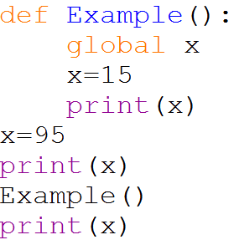
Accessing Global Variable inside Local Scope
Use global statement in the program.
Output is
95
15
15
T I P:-
Although Global Variables can be accessed through local scope, but it is not a good programming practice. So, keep global variable global and local variable local.

Slide 47
MUTABLE/ IMMUTABLE PROPERTIES OF PASSED DATA OBJECT
If a variable is referring to a mutable type then any change in its value will also change the memory address it is referring to.
If a variable is referring to an immutable type then any change in the value of mutable type will not change the memory address of the variable.
Mutable Parameter
Immutable Parameter

Slide 48
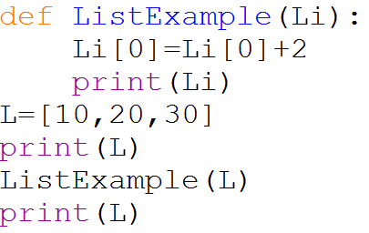
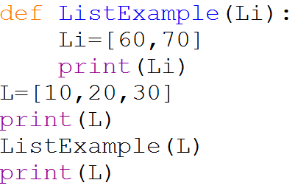
PASSING LIST AS FUNCTION PARAMETER
Lists are mutable data object
Output is
[10, 20, 30]
[12, 20, 30]
[12, 20, 30]
Output is
[10, 20, 30]
[60, 70]
[10, 20, 30]

Slide 49
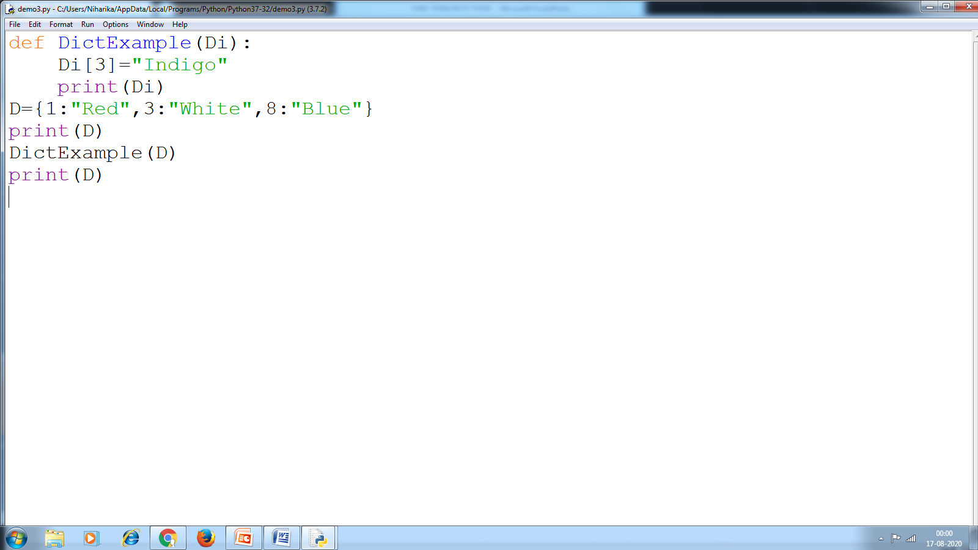
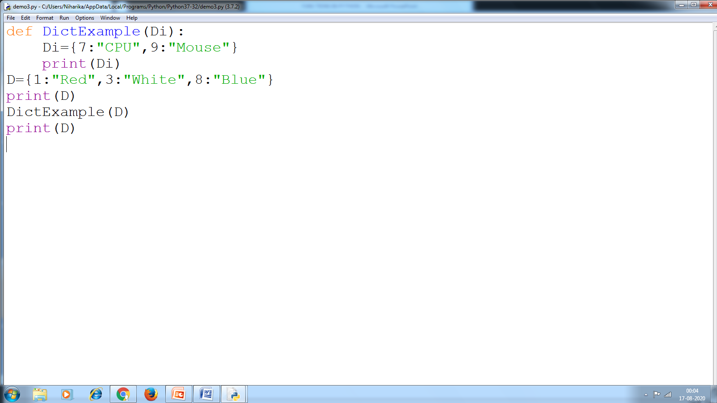
PASSING DICTIONARY AS FUNCTION PARAMETER
Dictionary is mutable data object
Output is
{1: 'Red', 3: 'White', 8: 'Blue'}
{1: 'Red', 3: 'Indigo', 8: 'Blue'}
{1: 'Red', 3: 'Indigo', 8: 'Blue'}
Output is
{1: 'Red', 3: 'White', 8: 'Blue'}
{7: 'CPU', 9: 'Mouse'}
{1: 'Red', 3: 'White', 8: 'Blue'}

Slide 50
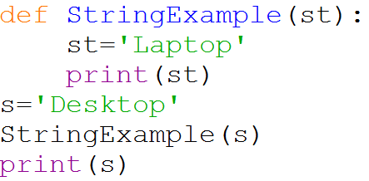
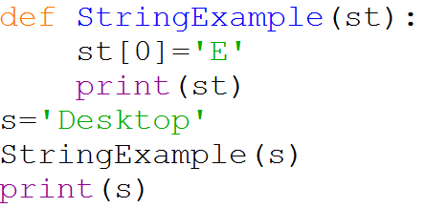
PASSING STRING AS FUNCTION PARAMETER
String is an immutable data object
Output is
Laptop
Desktop
ERROR

Slide 51

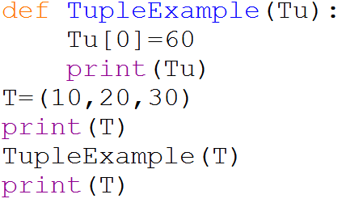
PASSING TUPLE AS FUNCTION PARAMETER
Tuples are immutable data object
Output is
(10, 20, 30)
[60, 70]
(10, 20, 30)
ERROR

Slide 52
Summary of Mutable/ Immutable properties of Data Objects
Changes in immutable types are not reflected in the caller function at all.
Changes, if any, in mutable types
Are reflected in caller function if its name is not assigned a different variable or data types.
Are not reflected in the caller function if it is assigned a different variable or data types.

Slide 53
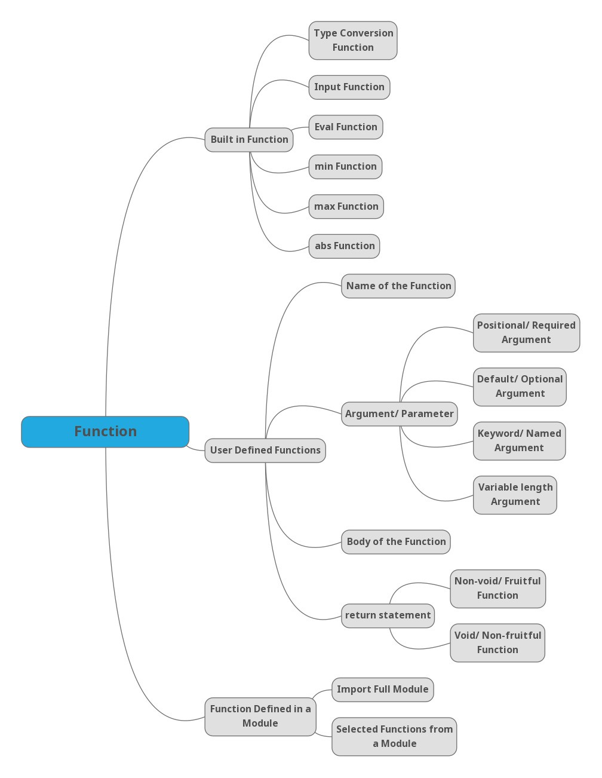
Concept Map

Slide 54
CBSE Sample Question
Write a Function namely Fun that takes no parameters and always returns None.
2. Find and write the output of the following python code:- def Update(A,B=25):
A=A+B
B=A-B
print(A,’#’,B)
return A
A=150
B=100
A=Update(A,B)
print(A,’#’,B)
3. Write a function that takes two numbers as parameter and returns the number that has minimum one’s digit. For example, if numbers passed are 491 and 278, then the function will return 491, because it has got minimum one’s digit out of two given numbers (491’s 1 is< 278’s 8).
SQP 2020

Slide 55
CBSE Sample Question
4. Write a Function that takes amount in Dollar and convert it into rupees.
5. Write a function that takes two numbers as its parameter and generates 2 random numbers from that range.
6. Write a function that takes two strings as its argument and checks whether they are same length strings (return True in this case, otherwise returns False.
7. Write a program that takes an integer as its parameter and returns True, if it is a prime number.
SQP 2020

